Slide 1
A Climate Counternarrative
“The Science” is Wrong: It’s Soil, Not Oil
Denis de Bernardy <ddebernardy@proton.me>

Slide 2
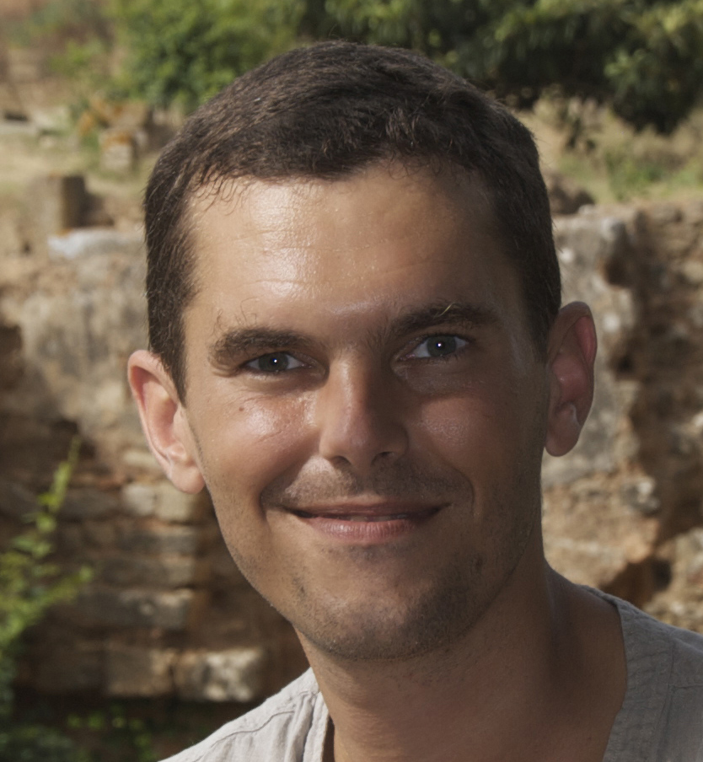
Denis de Bernardy
Appalled Environmentalist
Engineer triggered by dubious climate science and solutions
Agroecology, permaculture
Author of A Natural Language:
Environmental big lies
Carbon accounting chicanery
Solutions to actual problems

Slide 3
Environmental Big Lies

Slide 4
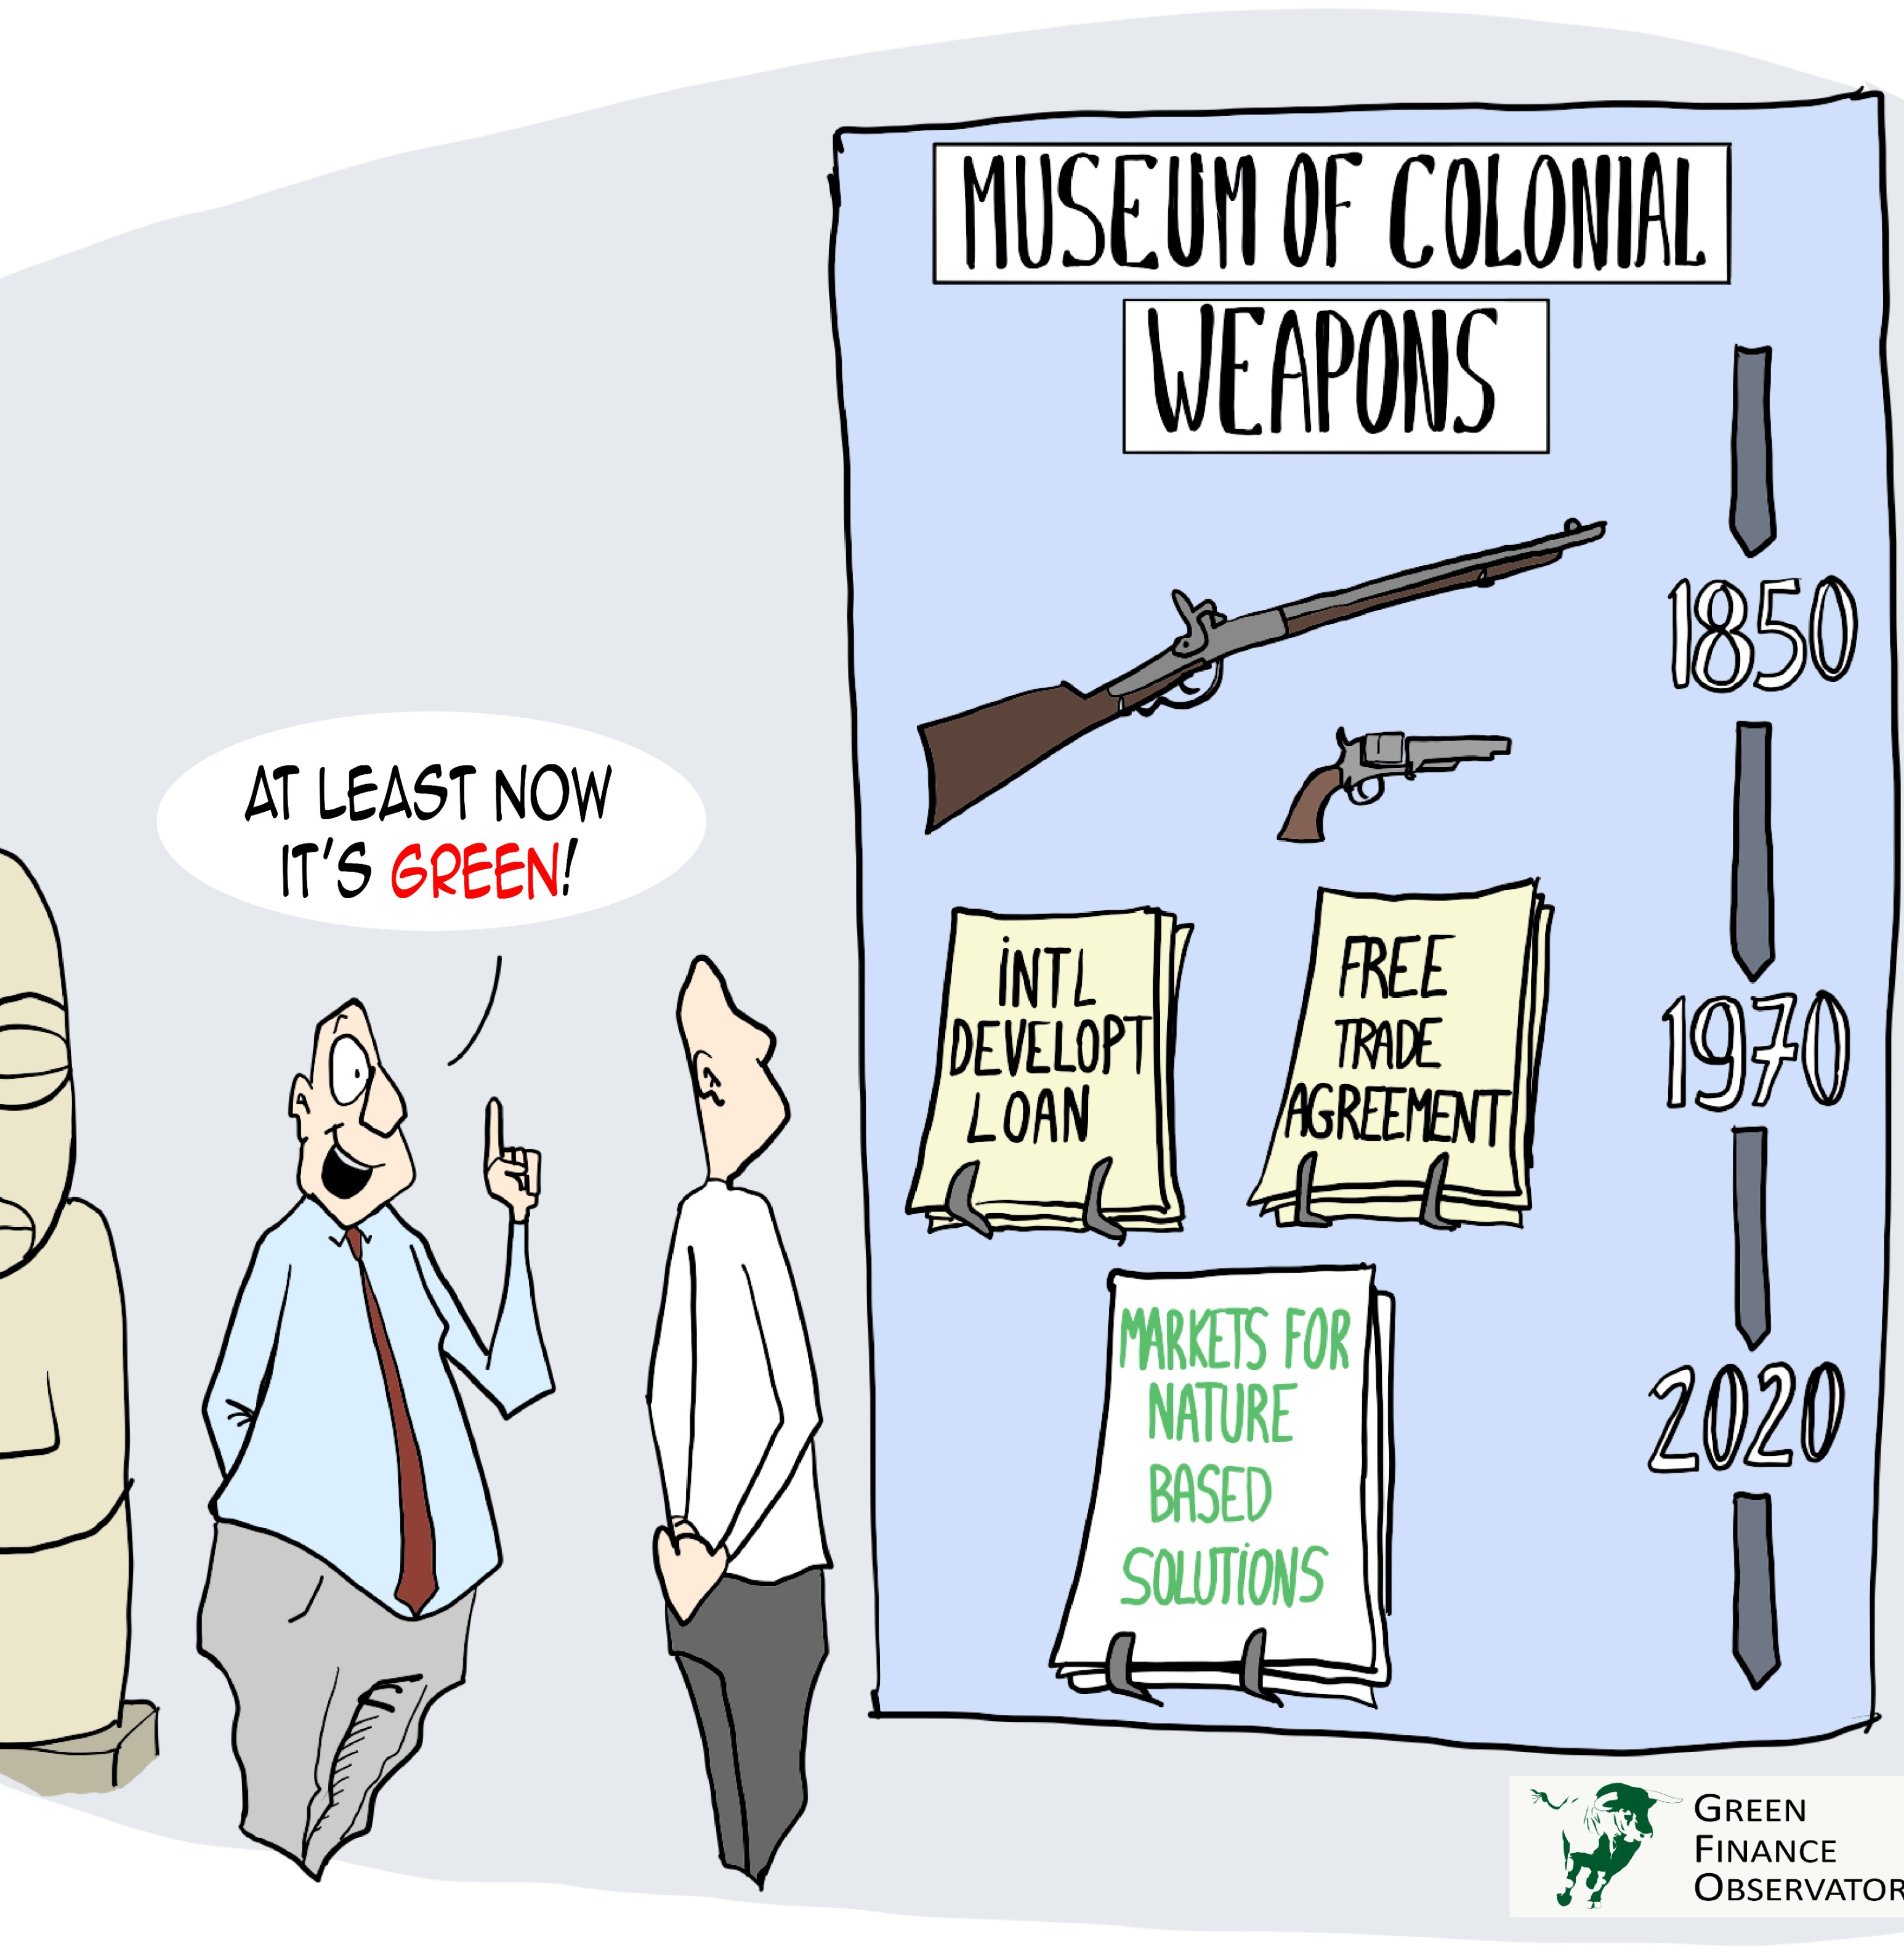
Climate “Solutions”
Green Imperialism
Green tech: military-driven mining
Carbon allowances (caps), taxes, and offsets: control infrastructure
Carbon capture and storage:
Subsidies for fossil fuel giants and tree plantation operators
Land grabs by conservancies
Geo-engineering: weather warfare
Credit: Green Finance Observatory

Slide 5
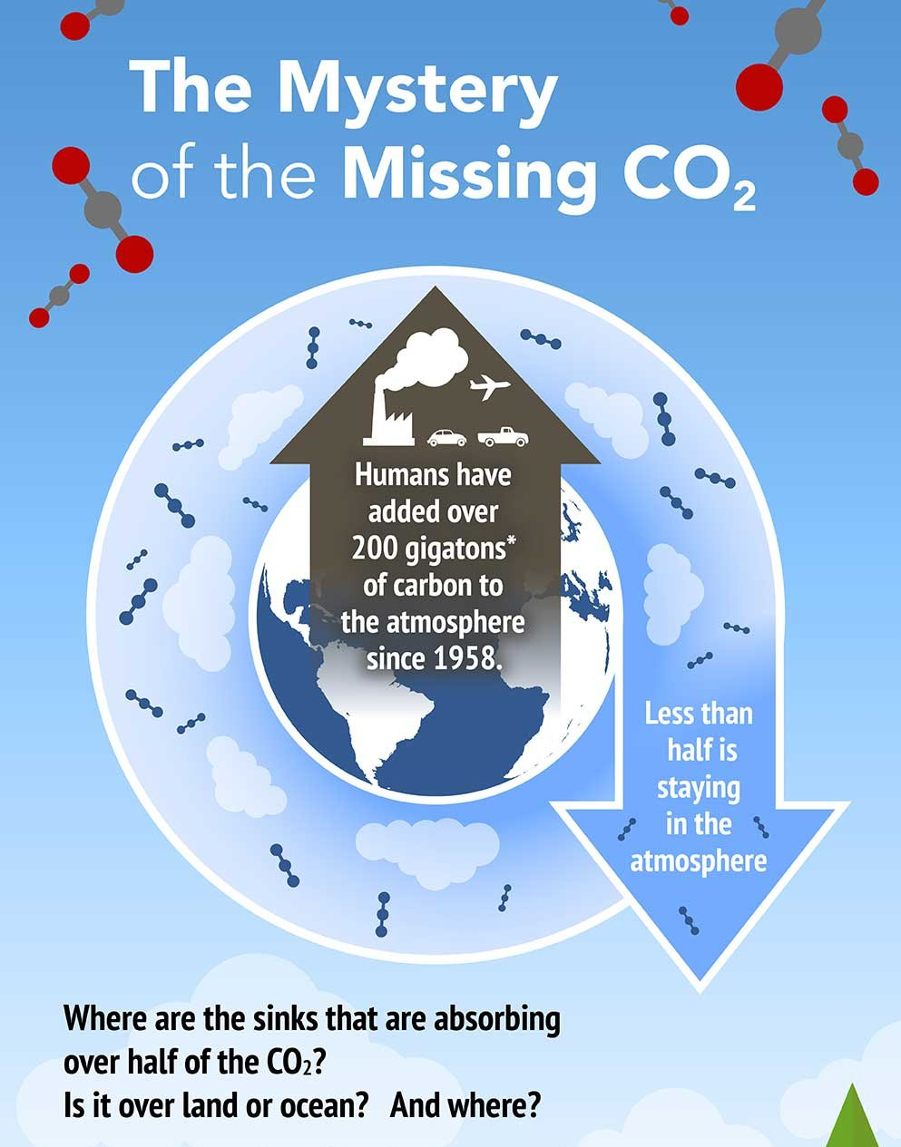
Climate “Science”
A Manufactured Consensus
Doctored research that ignores:
Conflicting data and dynamics
Geological effects (volcanos)
Basic modeling principles
Malthusian and religious twists:
Aura of inevitability (overshoot)
Discounts land stewardship
Credit: NASA OCO-3 mission / science

Slide 6
“The Science” is so bad it doesn’t even get the CO2 attribution right.

Slide 7
Canopy Loss

Slide 8
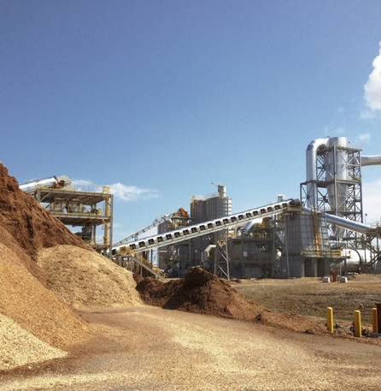
Biomass Energy
The Giveaway
Reviled by just about everyone
Logging produces biogenic CO2 emissions that get reported as land-use emissions (i.e. zero)
To avoid double counting, no CO2 gets reported for burning forestry waste as energy
Lavish green subsidies (Drax, biomass co-firing in Korea)

Slide 9
The CO2 tied to burning forestry waste is the tip of the iceberg.

Slide 10
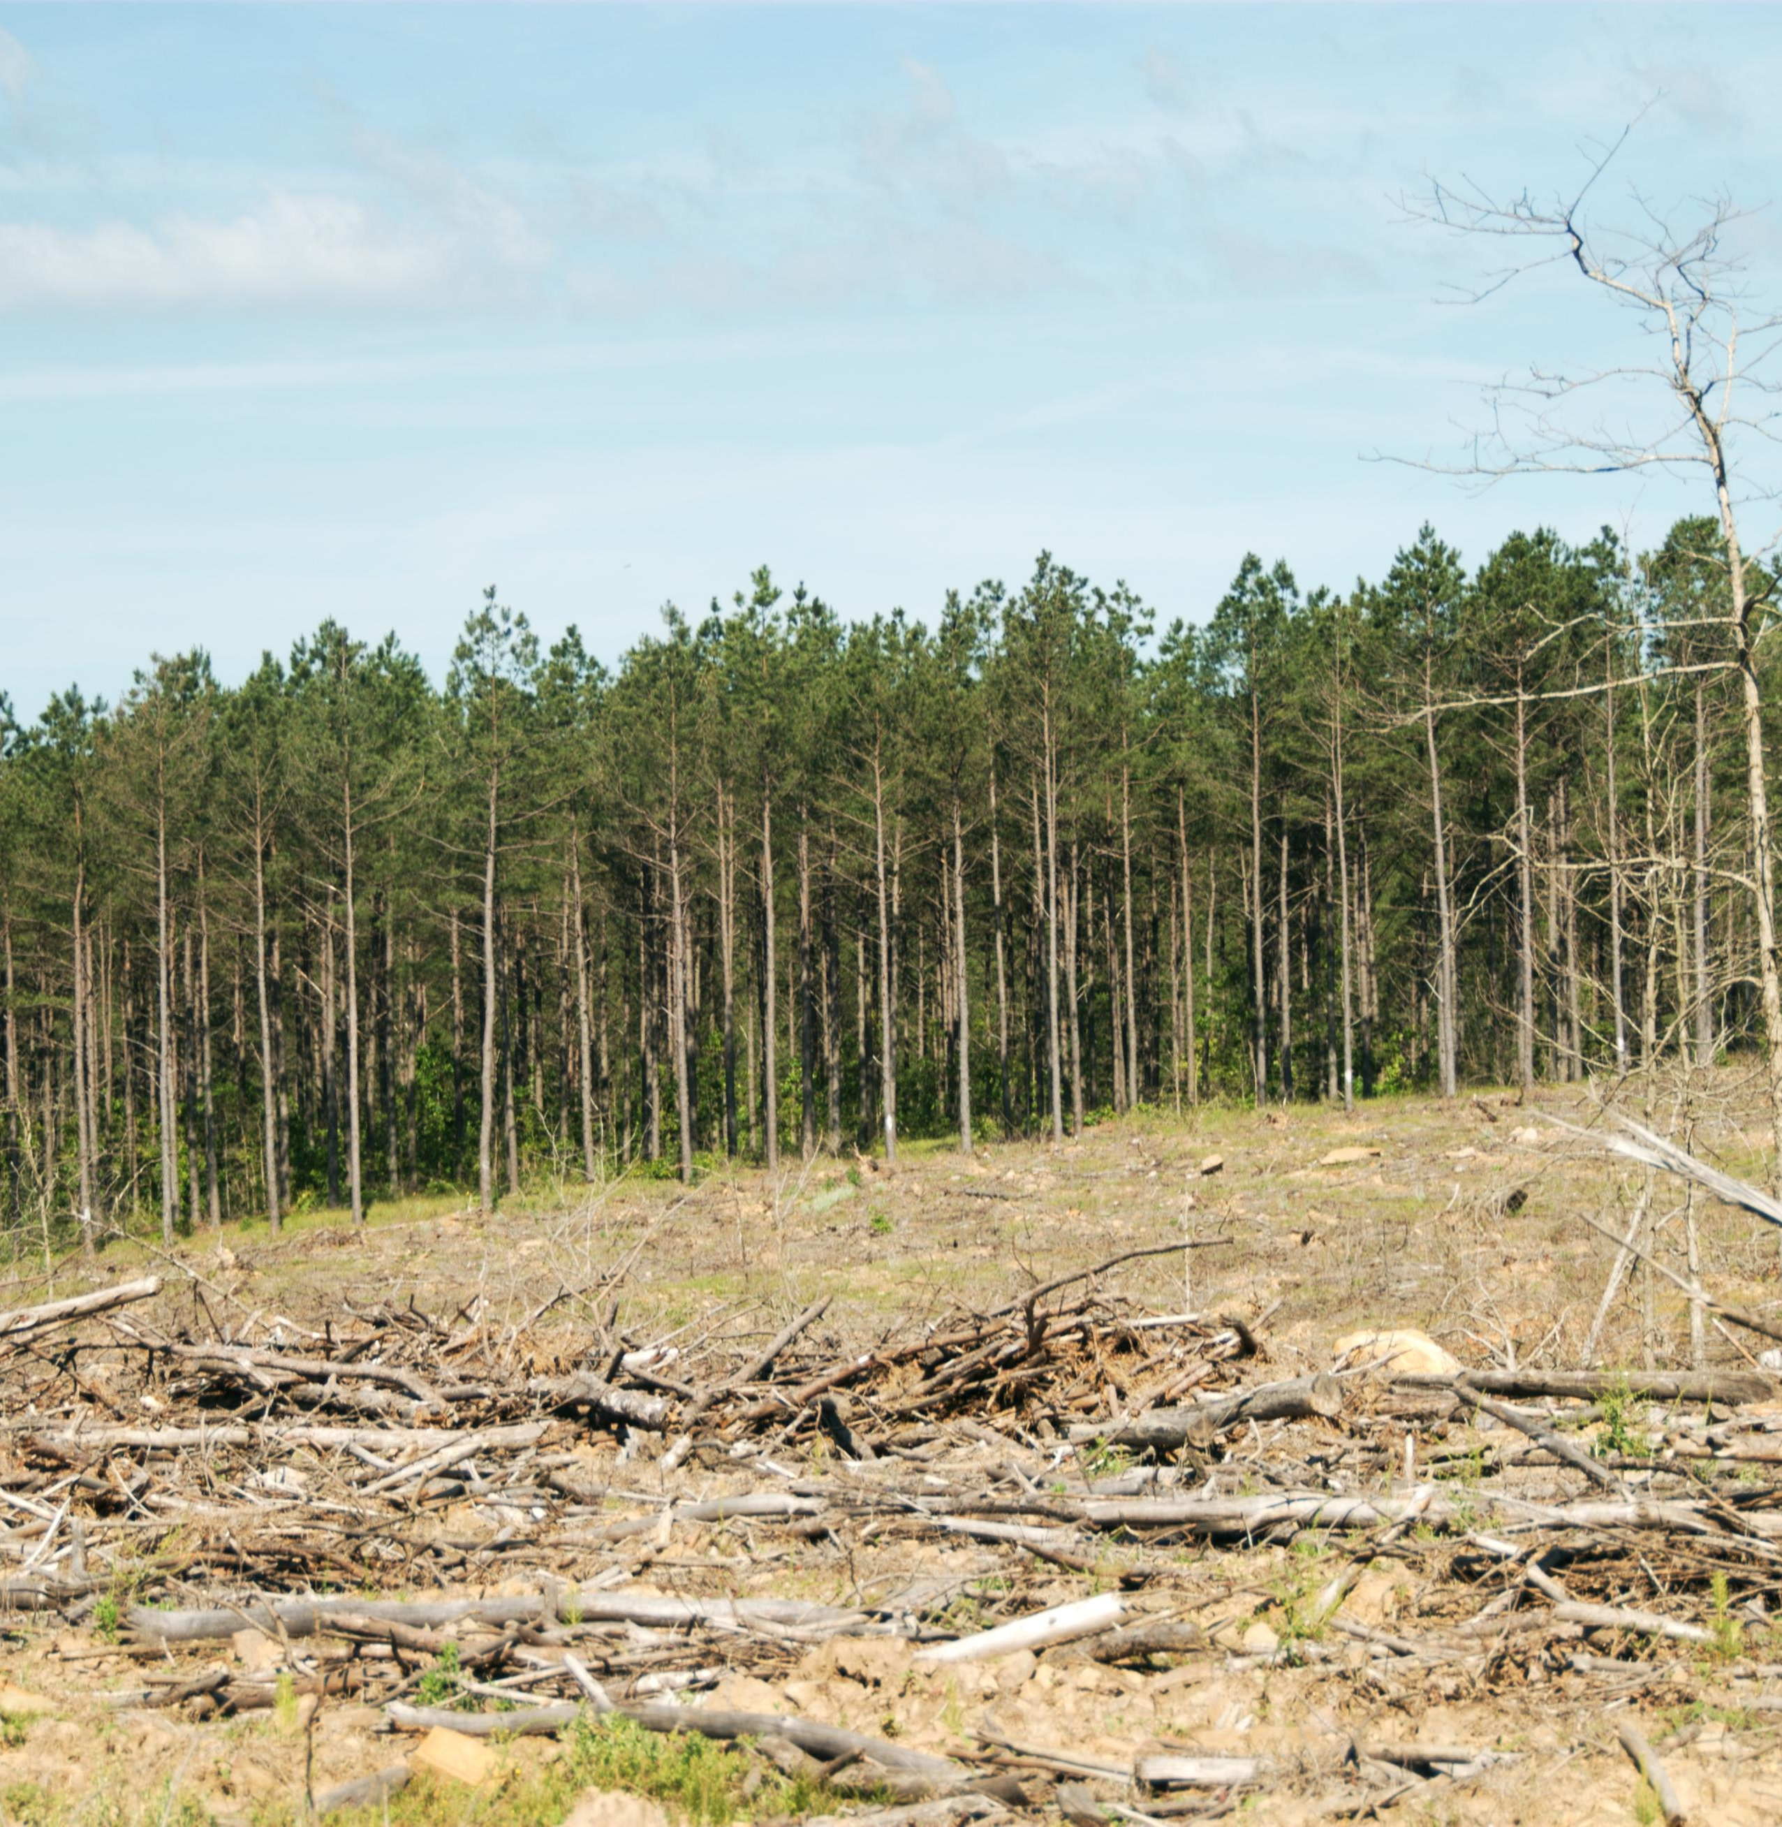
Forest Clear-Cuts
Avoidable Plumes of CO2
Plume of CO2 when you clear a forest (Korkiakoski et al, 2019)
Continues until the canopy is mature enough to soak it up
No plume when you thin a forest instead (Vesala et al, 2015)
Trees keep the fungi alive, break the wind, and soak up the CO2 emitted beneath the canopy

Slide 11
Carbon cycle research, charts, and visualizations distract from these surface level interactions.

Slide 12
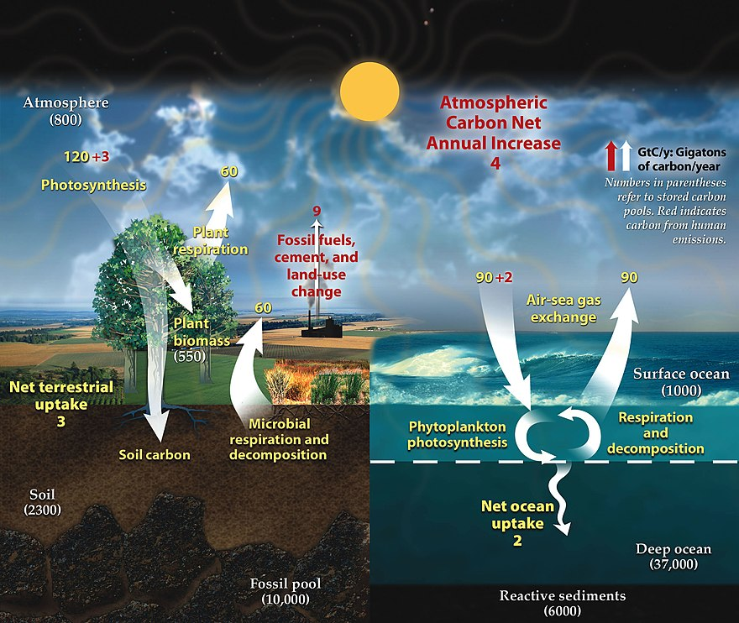

Slide 13
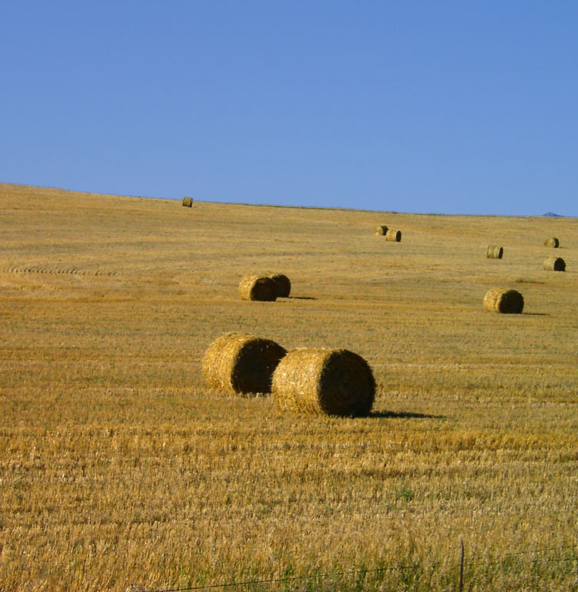
Canopy Loss
What Actually Changed
Loggers switched to clear-cutting
Farmers removed hedgerows:
Fewer, larger landowners
Industrialized farming
Other canopy-related changes:
US Midwest, Great Steppes
Deforestation, dead waters (?)

Slide 14
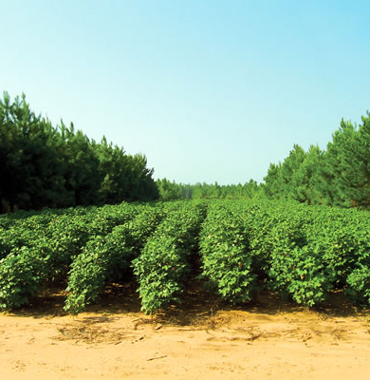
Avoidable Plumes
Keep Plants in the Ground
Simple and profitable to curb:
Forest thinning, mosaic system
Alley cropping, intercropping
Sylvopasture, rotational grazing
Short-cycle coppicing for biomass would keep crop yield impacts low
Would also solve biodiversity loss (roadsides, “re-wilded” gardens)

Slide 15
Open question: best approaches to use the inevitable CO2 plumes?

Slide 16
Carbon Accounting Chicanery

Slide 17
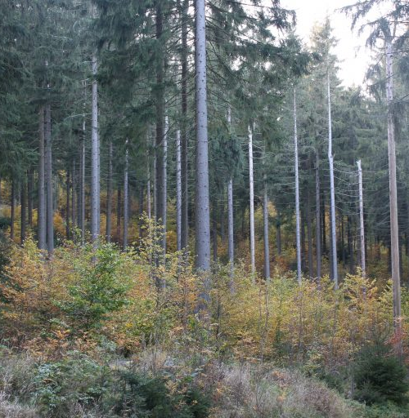
Forestry Models
Designed in Good Faith
Transition matrixes move carbon stocks from one discrete state to the next
Sound choice, since continuous tracking would be impractical
That tracks the net contribution of these avoidable plumes
These avoidable plumes thereby go uncounted and unreported
Credit: Andreas Pommer for the European Forest Institute

Slide 18
The numbers reported under Land Use 4.A.1 “Forest land remaining forest land” are based on models.

Slide 19

Carbon Accounting
Contrived By Financiers
Works like a financial statement
Cherrypicked emission sources get vilified as reducible expenses
Carbon stocks are more like balance sheet entries:
Tracked as stock changes
Keeps internal emissions out of view (and out of scrutiny)

Slide 20
Makes sense if and only if the avoidable emissions hidden in stocks are negligible.

Slide 21
Soil Emissions

Slide 22
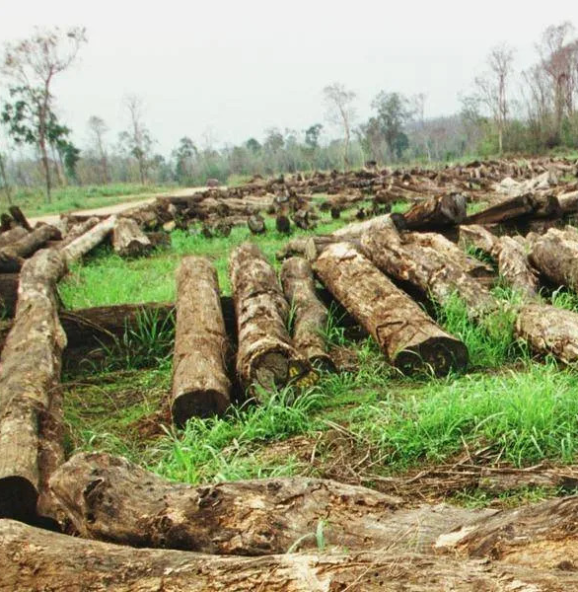
Logging Emissions
Anything But Negligible
A few kg of CO2 per sq. meter (Korkiakoski et al, 2019)
About 10 tons of CO2 per acre
Loggers clear over 60 million acres per year
A German economy or so worth of avoidable CO2 emissions
Kicker: Reduced-Impact Logging

Slide 23
Loggers stand to pocket carbon offsets to curb these plumes.

Slide 24
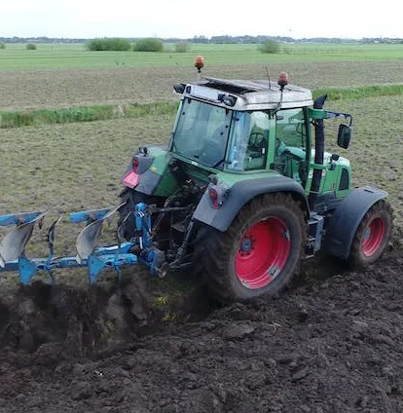
Farming Emissions
The Elephant in the Room
Vary widely (Abdalla et al, 2016)
Localized: a few grams (no-till) to dozens of grams (till) of CO2 per sq. meter in 5h (Reicosky, 1997)
About 25kg (no-till) or 100-400kg (till) of CO2 per acre
340 million acres of farmlands under temporary crops in the US alone (~8.5Gt of no-till CO2)

Slide 25
You can tell when farmers are tilling, harvesting, or using fire to clear fields.

Slide 26
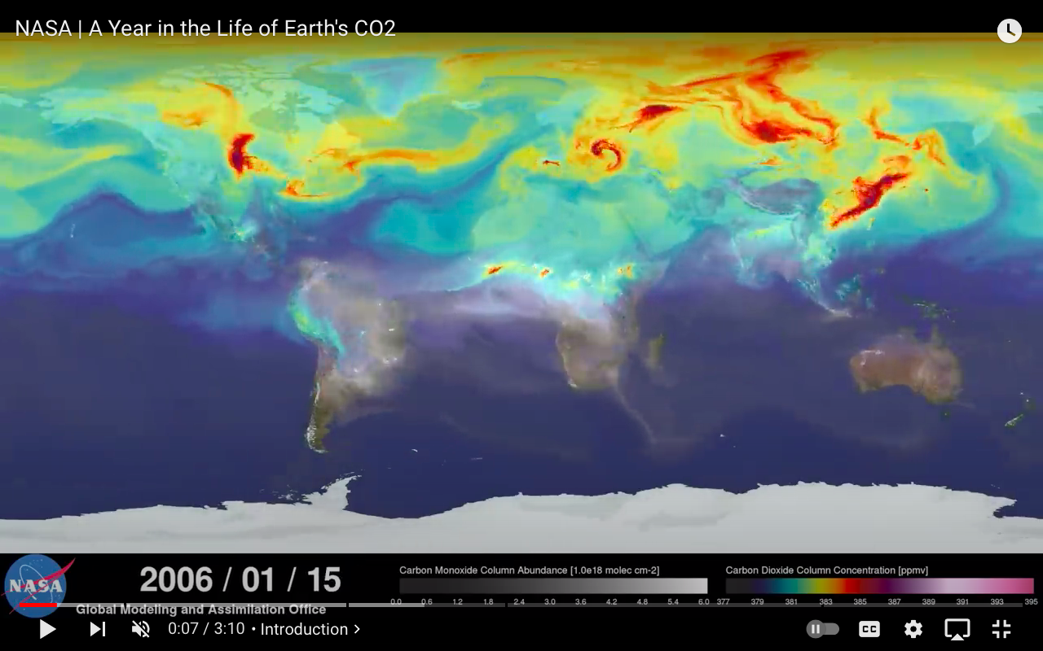
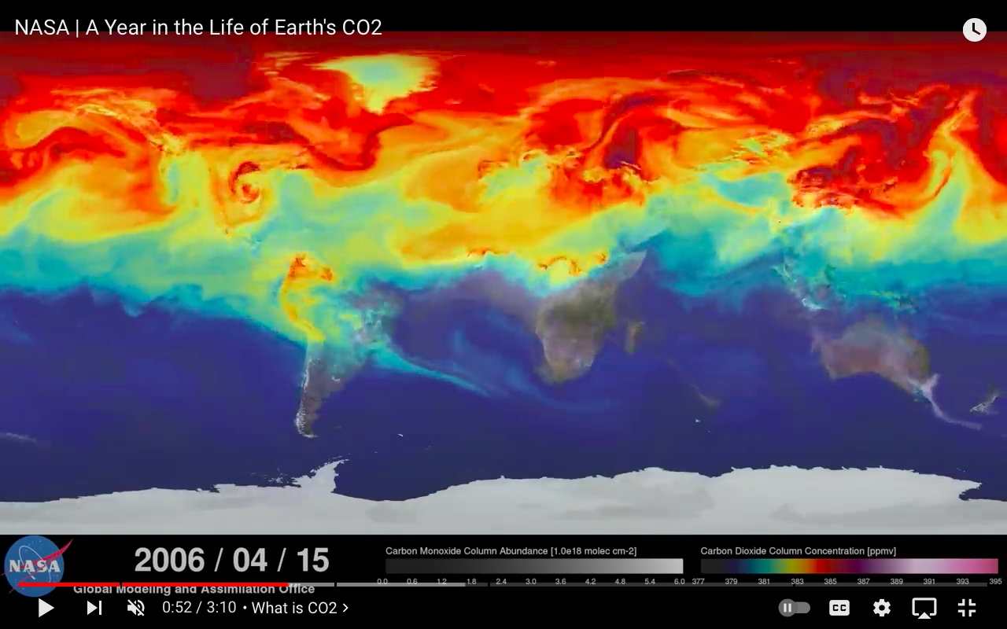
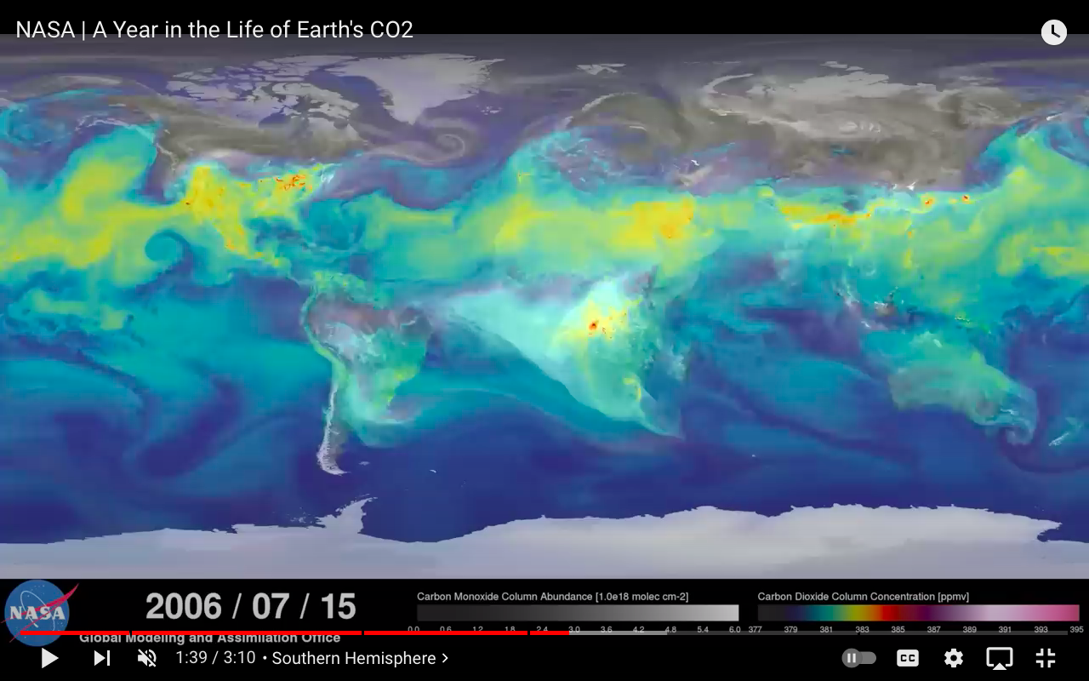
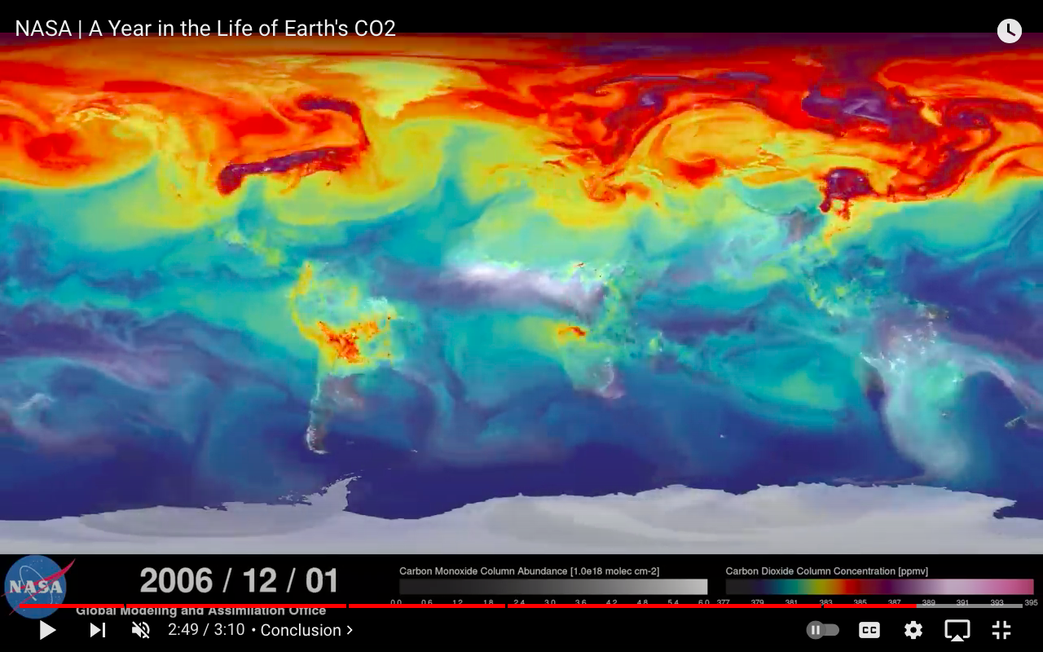

Slide 27
“The Science” is confusing a canopy loss problem for an energy problem.

Slide 28
Industrialized Bio-Sequestration

Slide 29
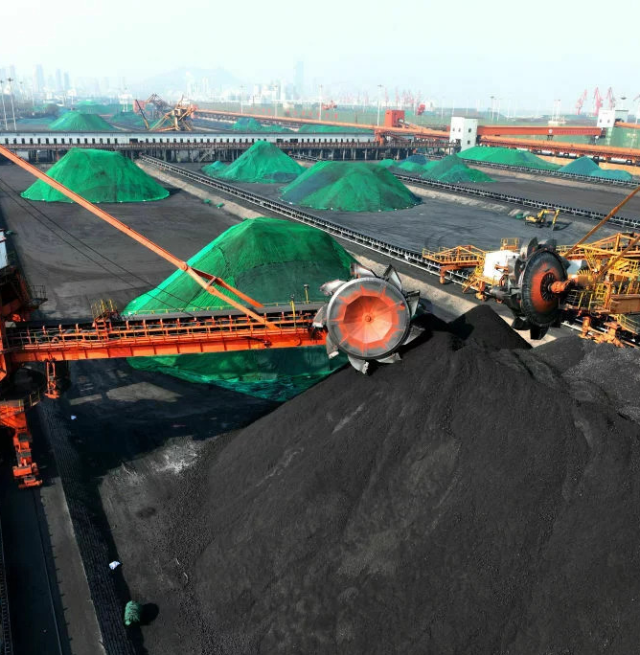
Fossil Fuels
(Not So) Unfairly Vilified
Naive isotopic analyses can’t tell if plants are cycling the fossil fuel carbon or not
Only 12% of the CO2 is tied to fossil fuels (Skrable et al, 2022)
CO2 increased like clockwork despite the 2020 lockdowns
Sources with little or no nearby plants (planes, smokestacks)
Credit: Visual China Group

Slide 30
Make no mistake: there isn’t much to love about fossil fuels (or any mining). But energy is critical, and so is CO2.

Slide 31
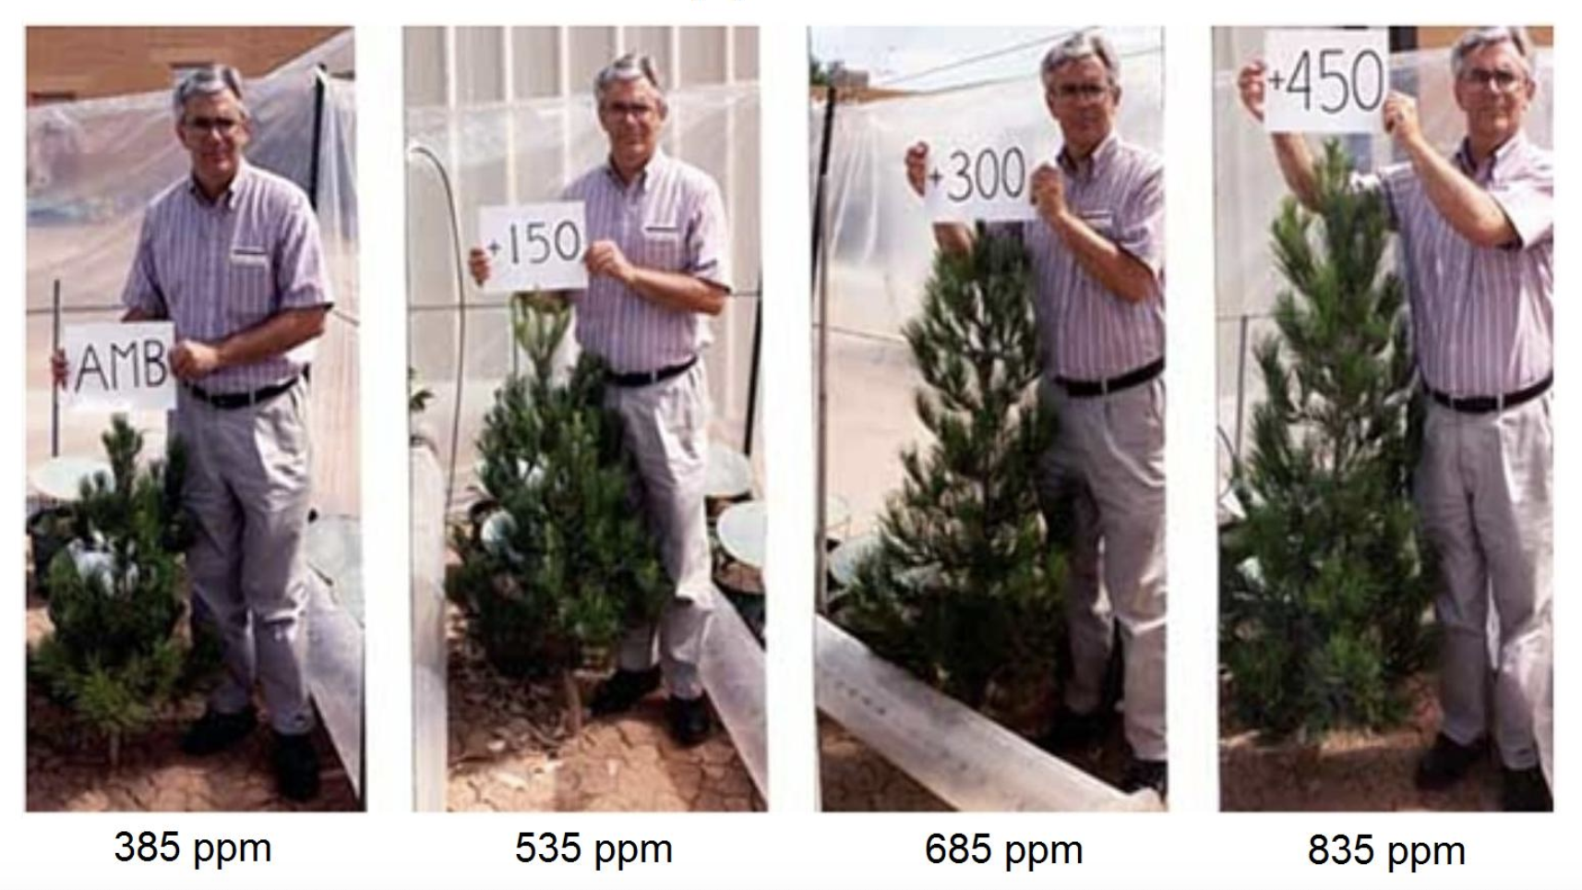
CO2 is Plant Food
Dr. Sherwood B. Idso showing the effects of CO2. (Idso and Idso, 1994)

Slide 32
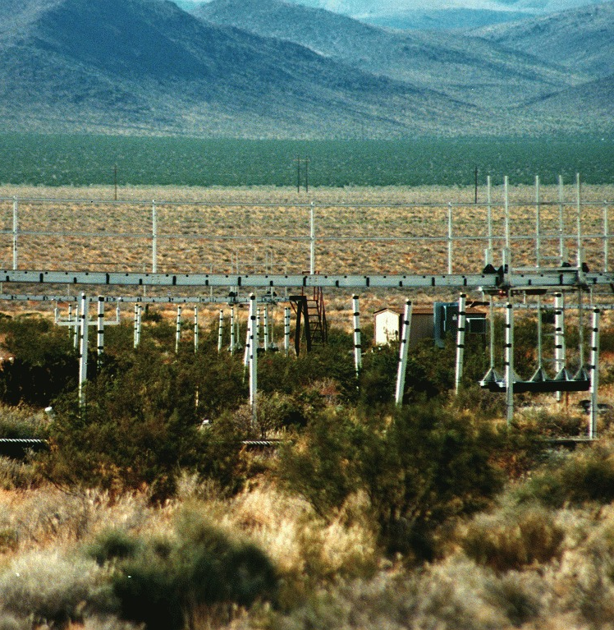
Bio-Sequestration
Hemp CO2 Fertilization
Capture the smokestack’s output (rocket mass heater like setup)
Filter/process as needed (pH)
Put the heat to good use
Pipe the output towards plants (drip irrigation/FACE like setup)
Hemp soaks up toxins and has many industrial uses

Slide 33
Or just let the CO2 escape freely. Plants are soaking it up just fine.

Slide 34
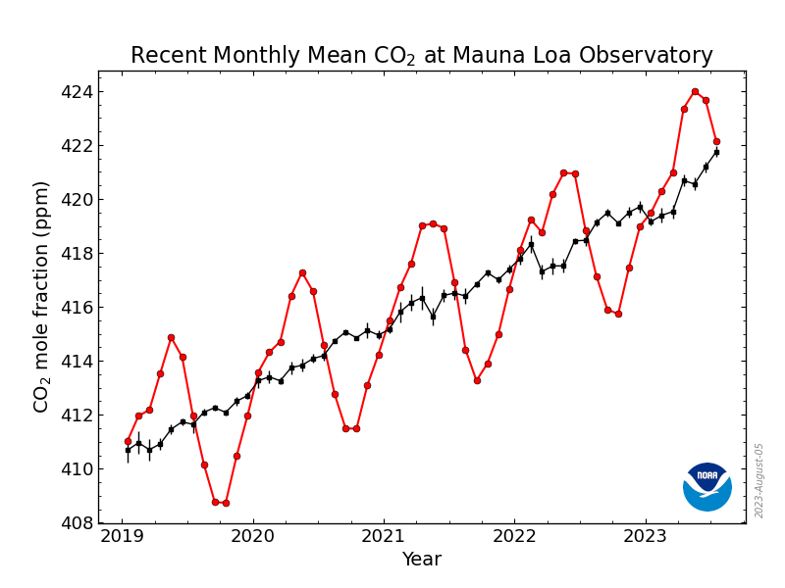
What we’d need to curb if CO2 was a problem.

Slide 35
The Missing CO2
Piecing the Story Together
Plants soak up most of the CO2
Biology moves the C around
Clearing fields releases it as CO2
Wind moves it around (esp. to the North pole)
Plants (esp. algae) soak it up
Biology moves the C around…
Credit: NASA OCO-3 mission / science

Slide 36
Clearly, there is no emergency. We need more CO2, if anything. (Just not from topsoil loss.)

Slide 37
Environmental (Non-)Crises

Slide 38
Topsoil loss actually matters if you value healthy food. It also genuinely affects the climate.

Slide 39

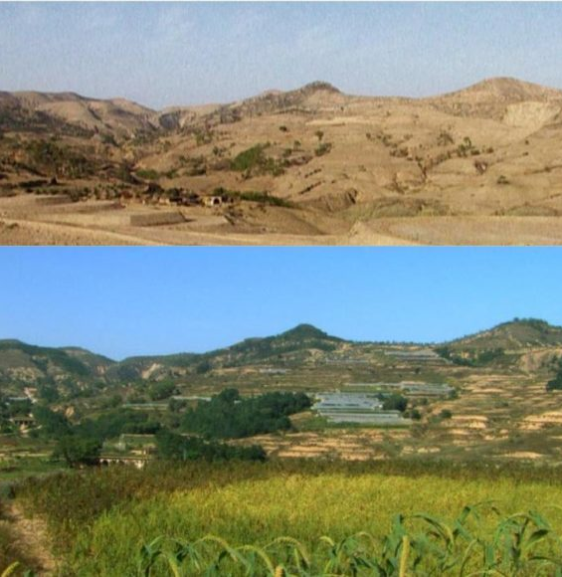
Climate Change
Man-Made Desertification
Soil with less carbon (and less cover) holds less water:
Runoffs, water evaporation, and hot air build-up lower moisture
Drier, warmer landscapes
Cycle of droughts and floods
Straightforward to reverse
Loess Plateau, China, before and after restoration

Slide 40
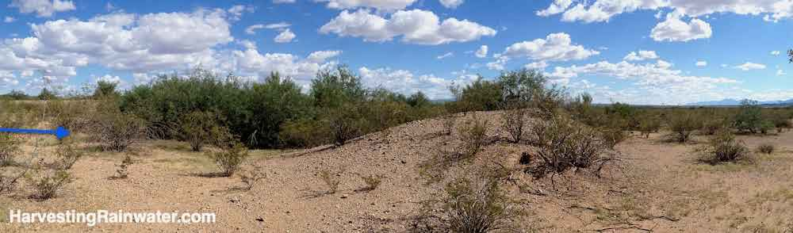
Bulldozers, seed pellets, and fencing can quickly transform a landscape.
Depression-era swale in Tucson, Arizona. The blue arrow shows the water flow. Photo: Brad Lancaster (2014).

Slide 41
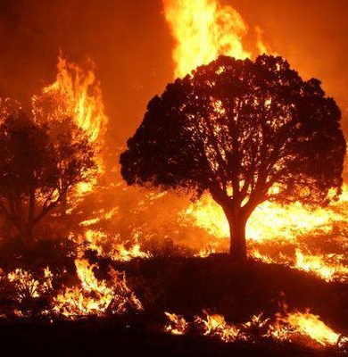
Natural Disasters
Man-Made Calamities
Poor land stewardship:
Poor water harvesting
Poor infrastructure
Industrialized plantations
Other man-made factors:
Aerial coal fly ash releases
Subsidized flood insurance

Slide 42

Mass Extinction
Man-Made Habitat Loss
Species are cornered, but fine
Authoritarian inversion of reality
Biggest land grab in history
Nature self-organizes holistically:
Dynamic, not static
Resilient, not optimal
Additive, not subtractive
Credit: Tim Lane / Guy Shield for Buzzfeed News: WWF’s Secret War

Slide 43
The only real concerns are pollution and stopping the green agenda.

Slide 44
Get Involved

Slide 45
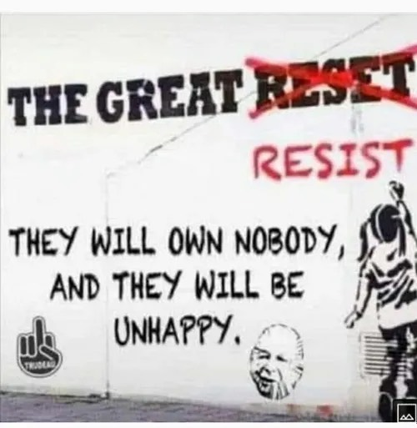
The Great Resist
Dismantling Oppression
Growing public awareness:
Contract-based coup
Depends on consent
Three power levers to dismantle:
Coercion: local autonomy
Legal: truth, jury annulment
Currency: local alternatives

Slide 46
You can put pressure on key enforcers by spreading the truth around them. (Tell their neighbors, colleagues, etc.)

Slide 47
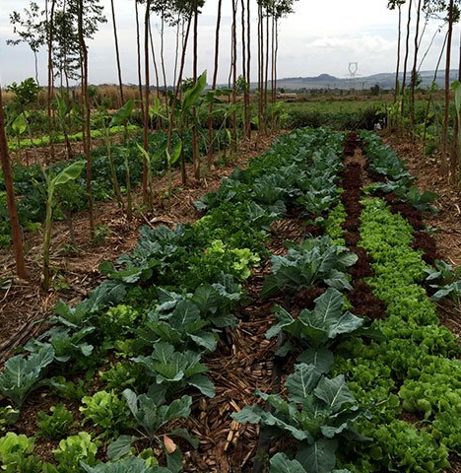
Hope, Not Anger
Offer Counternarratives
Factual information does not matter to demoralized people:
Truth bombs invite anger
Only they can do the work
Problem-reaction-solution hinges on (false) promises that give hope:
Solutions invite taking action
Making progress fuel hope
Syntropic Farm in Sitio Semente, Brasília - DF. Photo credit: ecoportal.net

Slide 48
Get climate activists to work on food sovereignty. It’s far more effective than blocking streets.

Slide 49
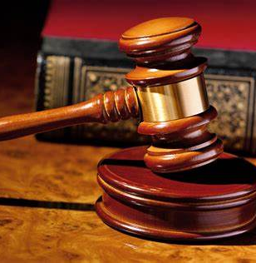
Legal Jiu-Jitsu
Let’s Work Together
Clearcut carbon accounting fraud:
Straightforward to understand
Indefensible in court
Crowdsourced legal campaign:
Confront key enablers
Repeal climate policies
Detonate green finance

Slide 50
Contribute / Support:
t.me/a_natural_language ddebernardy.substack.com/support

Slide 51
Useful Links
Spread the Word
The Big Lie That Climate Propagandists Don’t Want You To Talk About: https://ddebernardy.substack.com/p/the-big-lie
Carbon Accounting is Making a Canopy Problem Look Like an Energy Problem (non-editorialized): https://eartharxiv.org/repository/view/5378/
A Climate Counternarrative: https://ddebernardy.substack.com/p/a-climate-counternarrative
Git repository (this deck and printable documents): https://github.com/ddebernardy/a-climate-counternarrative

Slide 52
Thanks for your time!
twitter.com/ddebernardy • ddebernardy@proton.me

